Slide 1
Decision Tree and Random Forest

Slide 2
Introduction
Decision tree is a type of supervised learning algorithm (having a pre-defined target variable) that is mostly used in classification problems.
It works for both categorical and continuous input and output variables.
In this technique, we split the population or sample into two or more homogeneous sets (or sub-populations) based on most significant splitter / differentiator in input variables.

Slide 3
Types of Decision Trees
Types of decision tree is based on the type of target variable we have. It can be of two types:
Categorical Variable Decision Tree: Decision Tree which has categorical target variable then it called as categorical variable decision tree. Example:- In above scenario of student problem, where the target variable was “Student will play cricket or not” i.e. YES or NO.
Continuous Variable Decision Tree: Decision Tree has continuous target variable then it is called as Continuous Variable Decision Tree.

Slide 4
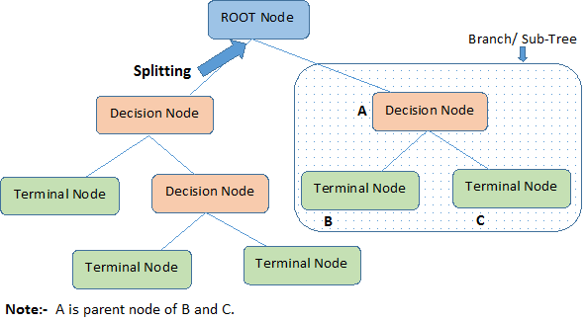

Slide 5
Terms
Root Node: It represents entire population or sample and this further gets divided into two or more homogeneous sets.
Splitting: It is a process of dividing a node into two or more sub-nodes.
Decision Node: When a sub-node splits into further sub-nodes, then it is called decision node.
Leaf/ Terminal Node: Nodes do not split is called Leaf or Terminal node.
Pruning: When we remove sub-nodes of a decision node, this process is called pruning. You can say opposite process of splitting.
Branch / Sub-Tree: A sub section of entire tree is called branch or sub-tree.
Parent and Child Node: A node, which is divided into sub-nodes is called parent node of sub-nodes where as sub-nodes are the child of parent node.

Slide 6
Advantages and disadvantages
Advantages
Easy to Understand
Useful in Data exploration
Less data cleaning required
Data type is not a constraint
Non Parametric Method
Disadvantages
Over fitting
Not fit for continuous variables

Slide 7
Regression Trees vs Classification Trees
Regression trees are used when dependent variable is continuous. Classification trees are used when dependent variable is categorical.
In case of regression tree, the value obtained by terminal nodes in the training data is the mean response of observation falling in that region. Thus, if an unseen data observation falls in that region, we’ll make its prediction with mean value.
In case of classification tree, the value (class) obtained by terminal node in the training data is the mode of observations falling in that region. Thus, if an unseen data observation falls in that region, we’ll make its prediction with mode value.
Both the trees divide the predictor space (independent variables) into distinct and non-overlapping regions. For the sake of simplicity, you can think of these regions as high dimensional boxes or boxes.
Both the trees follow a top-down greedy approach known as recursive binary splitting. We call it as ‘top-down’ because it begins from the top of tree when all the observations are available in a single region and successively splits the predictor space into two new branches down the tree. It is known as ‘greedy’ because, the algorithm cares (looks for best variable available) about only the current split, and not about future splits which will lead to a better tree.
This splitting process is continued until a user defined stopping criteria is reached. For example: we can tell the the algorithm to stop once the number of observations per node becomes less than 50.
In both the cases, the splitting process results in fully grown trees until the stopping criteria is reached. But, the fully grown tree is likely to overfit data, leading to poor accuracy on unseen data. This bring ‘pruning’. Pruning is one of the technique used tackle overfitting.

Slide 8
How does a tree decide where to split?
The decision of making strategic splits heavily affects a tree’s accuracy. The decision criteria is different for classification and regression trees.
Gini Index
Chi-Square
Information Gain
Reduction in Variance

Slide 9
Gini Index
It works with categorical target variable “Success” or “Failure”.
It performs only Binary splits
Higher the value of Gini higher the homogeneity.
CART (Classification and Regression Tree) uses Gini method to create binary splits.

Slide 10
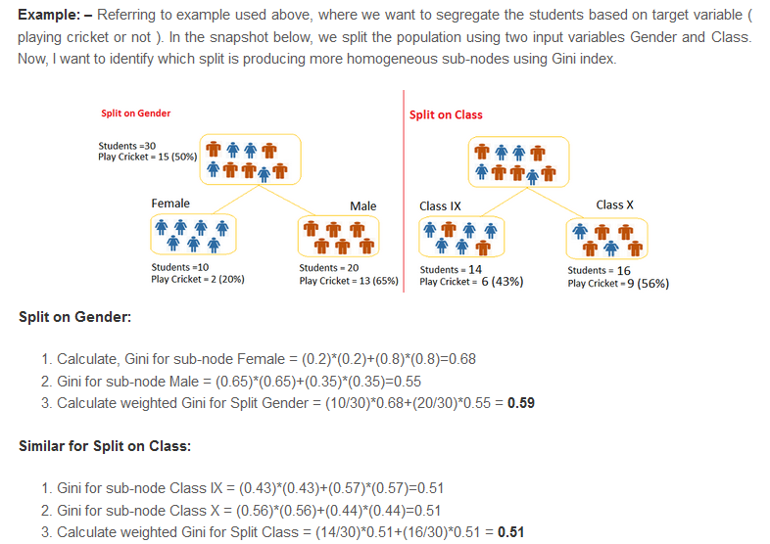

Slide 11
Chi-Square
It is an algorithm to find out the statistical significance between the differences between sub-nodes and parent node.
We measure it by sum of squares of standardized differences between observed and expected frequencies of target variable.
It works with categorical target variable “Success” or “Failure”.
It can perform two or more splits.
Higher the value of Chi-Square higher the statistical significance of differences between sub-node and Parent node.
Chi-Square of each node is calculated using formula,
Chi-square = ((Actual – Expected)^2 / Expected)^1/2
It generates tree called CHAID (Chi-square Automatic Interaction Detector)

Slide 12
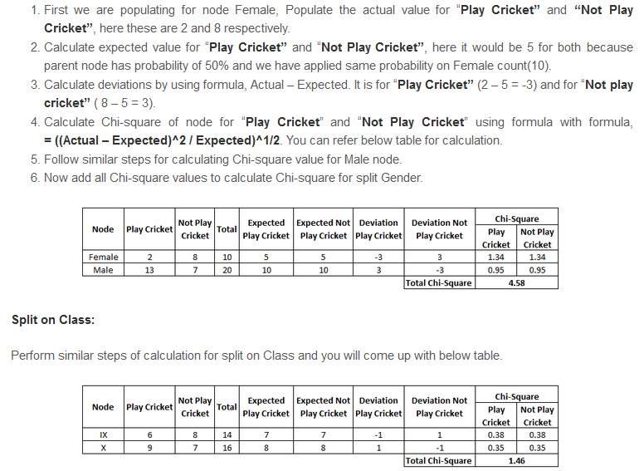

Slide 13
Information Gain
Information theory is a measure to define this degree of disorganization in a system known as Entropy. If the sample is completely homogeneous, then the entropy is zero and if the sample is an equally divided (50% – 50%), it has entropy of one.
Entropy can be calculated using formula:

Slide 14
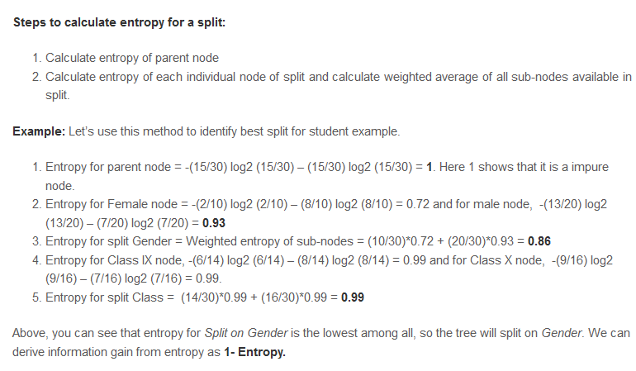

Slide 15

Reduction in Variance
Reduction in variance is an algorithm used for continuous target variables (regression problems).
This algorithm uses the standard formula of variance to choose the best split.
The split with lower variance is selected as the criteria to split the population:

Slide 16
Overfitting
Overfitting is one of the key challenges faced while modeling decision trees.
If there is no limit set of a decision tree, it will give you 100% accuracy on training set because in the worse case it will end up making 1 leaf for each observation.
Thus, preventing overfitting is pivotal while modeling a decision tree and it can be done in 2 ways:
Setting constraints on tree size
Tree pruning

Slide 17
Setting Constraints on Tree Size
Minimum samples for a node split
Minimum samples for a terminal node (leaf)
Maximum depth of tree (vertical depth)
Maximum number of terminal nodes
Maximum features to consider for split

Slide 18
Tree Pruning
We first make the decision tree to a large depth.
Then we start at the bottom and start removing leaves which are giving us negative returns when compared from the top.
Suppose a split is giving us a gain of say -10 (loss of 10) and then the next split on that gives us a gain of 20. A simple decision tree will stop at step 1 but in pruning, we will see that the overall gain is +10 and keep both leaves.

Slide 19
Random Forest

Slide 20
Random Forest
Random Forest is a versatile machine learning method capable of performing both regression and classification tasks.
It also undertakes dimensional reduction methods, treats missing values, outlier values and other essential steps of data exploration, and does a fairly good job.
It is a type of ensemble learning method, where a group of weak models combine to form a powerful model.

Slide 21
Random Forest
Assume number of cases in the training set is N. Then, sample of these N cases is taken at random but with replacement. This sample will be the training set for growing the tree.
If there are M input variables, a number m<M is specified such that at each node, m variables are selected at random out of the M. The best split on these m is used to split the node. The value of m is held constant while we grow the forest.
Each tree is grown to the largest extent possible and there is no pruning.
Predict new data by aggregating the predictions of the ntree trees (i.e., majority votes for classification, average for regression).

Slide 22
Advantages
This algorithm can solve both type of problems i.e. classification and regression and does a decent estimation at both fronts.
It can handle thousands of input variables and identify most significant variables so it is considered as one of the dimensionality reduction methods. Further, the model outputs Importance of variable, which can be a very handy feature (on some random data set).
It has an effective method for estimating missing data and maintains accuracy when a large proportion of the data are missing.
It has methods for balancing errors in data sets where classes are imbalanced.
The capabilities of the above can be extended to unlabeled data, leading to unsupervised clustering, data views and outlier detection.

Slide 23
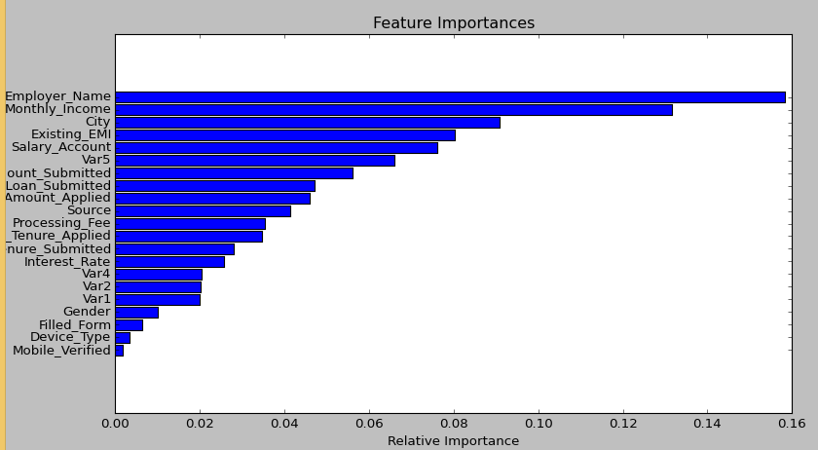
Variable Importance Curve

Slide 24
Disadvantages
It surely does a good job at classification but not as good as for regression problem as it does not give precise continuous nature predictions.
In case of regression, it doesn’t predict beyond the range in the training data, and that they may over-fit data sets that are particularly noisy.
Random Forest can feel like a black box approach for statistical modelers – you have very little control on what the model does. You can at best – try different parameters and random seeds!

Slide 25
Bootstrapping
Random Forest involves sampling of the input data with replacement called as bootstrap sampling.
Here part of the data is used for training and rest can be used to testing. These are called the out of bag samples.
Error estimated on these out of bag samples is known as out of bag error.
Study of error estimates by Out of bag, gives evidence to show that the out-of-bag estimate is as accurate as using a test set of the same size as the training set.
Therefore, using the out-of-bag error estimate removes the need for a set aside test set.

Slide 26
Boosting
The term ‘Boosting’ refers to a family of algorithms which converts weak learner to strong learners.
To convert weak learner to strong learner, we’ll combine the prediction of each weak learner using methods like:
Using average/ weighted average
Considering prediction has higher vote
To find weak rule, we apply Bayes learning algorithms with different distributions. Each time Bayes learning algorithm is applied, it generates a new weak prediction rule. This is an iterative process. After many iterations, the boosting algorithm combines these weak rules into a single strong prediction rule.

